Slide 1
Module #18:
Relations(1)
26年 11月 8日
©2001-2004 Michael P. Frank, revised by S. Kang

Slide 2
Binary Relations
Let A, B be any sets. A binary relation R from A to B, written (with signature) R:A×B, or R:A,B, is (can be identified with) a subset of the set A×B.
  E.g., let < : N↔N :≡ {(n,m) | n < m}
The notation a R b or aRb means that (a,b)∈R.
  E.g., a < b means (a,b)∈ <
If aRb we may say “a is related to b (by relation R)”,
  or just “a relates to b (under relation R)”.
A binary relation R corresponds to a predicate function P_{R}:A×B→{T,F} defined over the 2 sets A,B;
  e.g., predicate “eats” :≡ {(a,b)| organism a eats food b}
26年 11月 8日
©2001-2004 Michael P. Frank, revised by S. Kang

Slide 3
Complementary Relations
Let R:A,B be any binary relation.
Then, R:A×B, the complement of R, is the binary relation defined by
R :≡ {(a,b) | (a,b)∉R} = (A×B) − R
Note this is just R if the universe of discourse is U = A×B; thus the name complement.
Note the complement of R is R.
Example: < = {(a,b) | (a,b)∉<} = {(a,b) | ¬a<b} = ≥
26年 11月 8日
©2001-2004 Michael P. Frank, revised by S. Kang

Slide 4
Inverse Relations
Any binary relation R:A×B has an inverse relation R⁻¹:B×A, defined by
R⁻¹ :≡ {(b,a) | (a,b)∈R}.
E.g., <⁻¹ = {(b,a) | a<b} = {(b,a) | b>a} = >.
E.g., if R:People→Foods is defined by
a R b ⇔ a eats b, then:
b R⁻¹ a ⇔ b is eaten by a. (Passive voice.)
26年 11月 8日
©2001-2004 Michael P. Frank, revised by S. Kang

Slide 5
Relations on a Set
A (binary) relation from a set A to itself is called a relation on the set A.
E.g., the “<” relation from earlier was defined as a relation on the set N of natural numbers.
The (binary) identity relation I_{A} on a set A is the set {(a,a)|a∈A}.
26年 11月 8日
©2001-2004 Michael P. Frank, revised by S. Kang

Slide 6
Reflexivity
A relation R on A is reflexive if ∀a∈A, aRa.
  E.g., the relation ≥ :≡ {(a,b) | a≥b} is reflexive.
A relation R is irreflexive iff its complementary relation R is reflexive.
  Example: < is irreflexive, because ≥ is reflexive.
  Note “irreflexive” does NOT mean “not reflexive”!
    For example: the relation “likes” between people is not reflexive, but it is not irreflexive either.
      Since not everyone likes themselves, but not everyone dislikes themselves either!
26年 11月 8日
©2001-2004 Michael P. Frank, revised by S. Kang

Slide 7
Symmetry & Antisymmetry
A binary relation R on A is symmetric iff
R = R⁻¹, that is, if (a,b)∈R ↔ (b,a)∈R.
  E.g., = (equality) is symmetric. < is not.
  “is married to” is symmetric, “likes” is not.
A binary relation R is antisymmetric if
∀a≠b, (a,b)∈R → (b,a)∉R.
  Examples: < is antisymmetric, “likes” is not.
  Exercise: prove this definition of antisymmetric is equivalent to the statement that R∩R⁻¹ ⊆ I_{A}.
26年 11月 8日
©2001-2004 Michael P. Frank, revised by S. Kang

Slide 8
Transitivity
A relation R is transitive iff (for all a,b,c)
(a,b)∈R ∧ (b,c)∈R → (a,c)∈R.
A relation is intransitive iff it is not transitive.
Some examples:
  “is an ancestor of” is transitive.
  “likes” between people is intransitive.
  “is located within 1 mile of” is… ?
26年 11月 8日
©2001-2004 Michael P. Frank, revised by S. Kang

Slide 9
Totality
A relation R:A×B is total if for every a∈A, there is at least one b∈B such that (a,b)∈R.
If R is not total, then it is called strictly partial.
A partial relation is a relation that might be strictly partial. (Or, it might be total.)
  In other words, all relations are considered “partial.”
26年 11月 8日
©2001-2004 Michael P. Frank, revised by S. Kang

Slide 10
Functionality
A relation R:A×B is functional if, for any a∈A, there is at most 1 b∈B such that (a,b)∈R.
  “R is functional” ⇔ ∀a∈A: ¬∃b₁≠b₂∈B: aRb₁ ∧ aRb₂.
  Iff R is functional, then it corresponds to a partial function R:A→B
    where R(a)=b ⇔ aRb; e.g.
      E.g., The relation aRb :≡ “a + b = 0” yields the function −(a) = b.
R is antifunctional if its inverse relation R⁻¹ is functional.
  Note: A functional relation (partial function) that is also antifunctional is an invertible partial function.
R is a total function R:A→B if it is both functional and total, that is, for any a∈A, there is exactly 1 b such that (a,b)∈R.
I.e., ∀a∈A: ∃!b: aRb.
  If R is functional but not total, then it is a strictly partial function.
  Exercise: Show that iff R is functional and antifunctional, and both it and its inverse are total, then it is a bijective function.
26年 11月 8日
©2001-2004 Michael P. Frank, revised by S. Kang

Slide 11
Composite Relations
Let R:A×B, and S:B×C. Then the composite S□R of R and S is defined as:
S□R = {(a,c) | ∃b: aRb ∧ bSc}
Note that function composition f□g is an example.
Exer.: Prove that R:A×A is transitive iff R□R ⊆ R.
The n^{th} power R^{n} of a relation R on a set A can be defined recursively by:
R¹ :≡ R ; R^{n+1} :≡ R^{n}□R for all n≥0.
  Negative powers of R can also be defined if desired, by
  R^{−n} :≡ (R⁻¹)^{n}.
26年 11月 8日
©2001-2004 Michael P. Frank, revised by S. Kang

Slide 12
§7.2: n-ary Relations
An n-ary relation R on sets A₁,…,A_{n},
written (with signature) R:A₁×…×A_{n} or R:A₁,…,A_{n}, is simply a subset
R ⊆ A₁× … × A_{n}.
The sets A_{i} are called the domains of R.
The degree of R is n.
R is functional in the domain A_{i} if it contains at most one n-tuple (…, a_{i} ,…) for any value a_{i} within domain A_{i}.
26年 11月 8日
©2001-2004 Michael P. Frank, revised by S. Kang

Slide 13
Relational Databases
A relational database is essentially just an n-ary relation R.
A domain A_{i} is a primary key for the database if the relation R is functional in A_{i}.
A composite key for the database is a set of domains {A_{i}, A_{j}, …} such that R contains at most 1 n-tuple (…,a_{i},…,a_{j},…) for each composite value (a_{i}, a_{j},…)∈A_{i}×A_{j}×…
26年 11月 8日
©2001-2004 Michael P. Frank, revised by S. Kang

Slide 14
Selection Operators
Let A be any n-ary domain A=A₁×…×A_{n}, and let C:A→{T,F} be any condition (predicate) on elements (n-tuples) of A.
Then, the selection operator s_{C} is the operator that maps any (n-ary) relation R on A to the n-ary relation of all n-tuples from R that satisfy C.
  I.e., ∀R⊆A, s_{C}(R) = {a∈R | s_{C}(a) = T}
26年 11月 8日
©2001-2004 Michael P. Frank, revised by S. Kang

Slide 15
Selection Operator Example
Suppose we have a domain
A = StudentName × Standing × ResRegNos
Suppose we define a certain condition on A, UpperLevel(name,standing,rrn) :≡
[(standing = junior) ∨ (standing = senior)]
Then, s_{UpperLevel} is the selection operator that takes any relation R on A (database of students) and produces a relation consisting of just the upper-level classes (juniors and seniors).
26年 11月 8日
©2001-2004 Michael P. Frank, revised by S. Kang

Slide 16
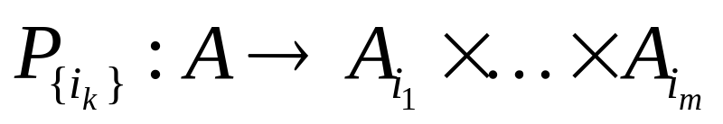
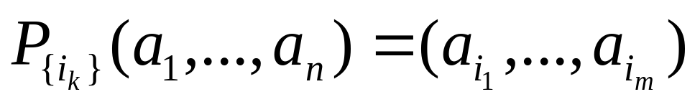
Projection Operators
Let A = A₁×…×A_{n} be any n-ary domain, and let {i_{k}}=(i₁,…,i_{m}) be a sequence of indices all falling in the range 1 to n,
  That is, where 1 ≤ i_{k} ≤ n for all 1 ≤ k ≤ m.
Then the projection operator on n-tuples
is defined by:
26年 11月 8日
©2001-2004 Michael P. Frank, revised by S. Kang

Slide 17
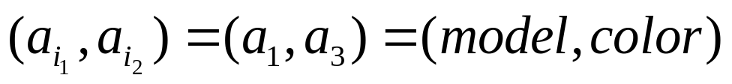
Projection Example
Suppose we have a ternary (3-ary) domain Cars=Model×Year×Color. (note n=3).
Consider the index sequence {i_{k}}= 1,3. (m=2)
Then the projection P simply maps each tuple (a₁,a₂,a₃) = (model,year,color) to its image:
This operator can be usefully applied to a whole relation R⊆Cars (a database of cars) to obtain a list of the model/color combinations available.
{i_{k}}
26年 11月 8日
©2001-2004 Michael P. Frank, revised by S. Kang

Slide 18
Join Operator
Puts two relations together to form a sort of combined relation.
If the tuple (A,B) appears in R₁, and the tuple (B,C) appears in R₂, then the tuple (A,B,C) appears in the join J(R₁,R₂).
  A, B, and C here can also be sequences of elements (across multiple fields), not just single elements.
26年 11月 8日
©2001-2004 Michael P. Frank, revised by S. Kang

Slide 19
Join Example
Suppose R₁ is a teaching assignment table, relating Professors to Courses.
Suppose R₂ is a room assignment table relating Courses to Rooms,Times.
Then J(R₁,R₂) is like your class schedule, listing (professor,course,room,time).
26年 11月 8日
©2001-2004 Michael P. Frank, revised by S. Kang

